Slide 1
IoT Standard and Protocols
More Introduction Stuff

Slide 2
Agenda
Components of an IoT Application
Single Board Computers
Microcontrollers

Slide 3
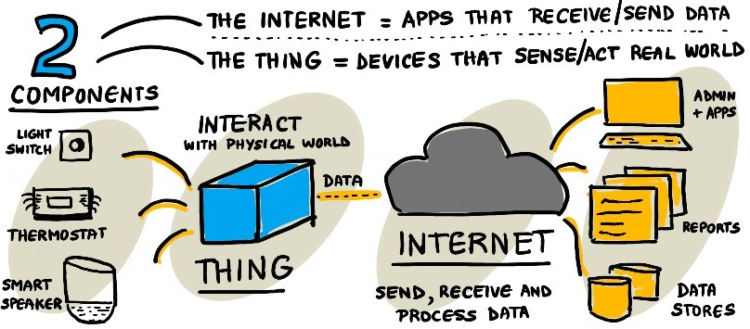
IoT Components

Slide 4
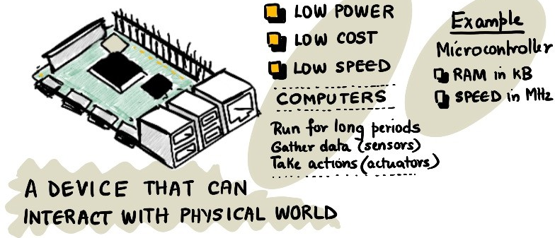
The “Thing”

Slide 5
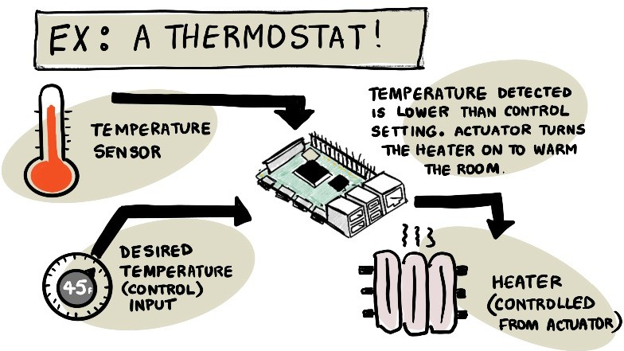

Slide 6

QI
What other things use sensor data to make decisions?

Slide 7
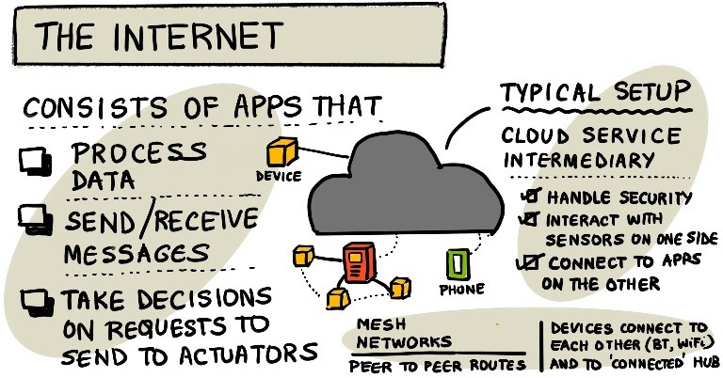
Internet

Slide 8
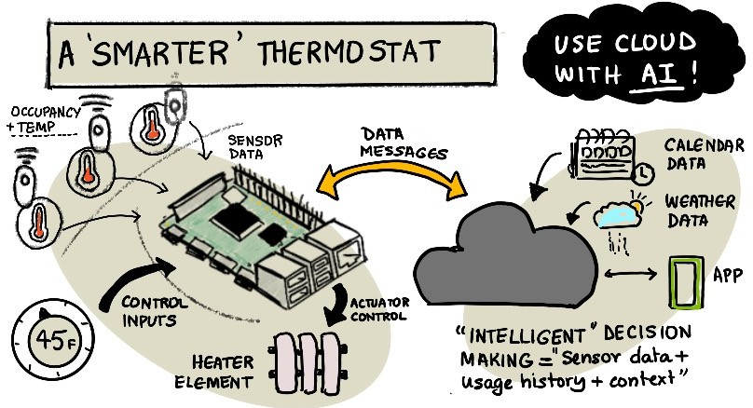
Build a Better Mousetrap

Slide 9
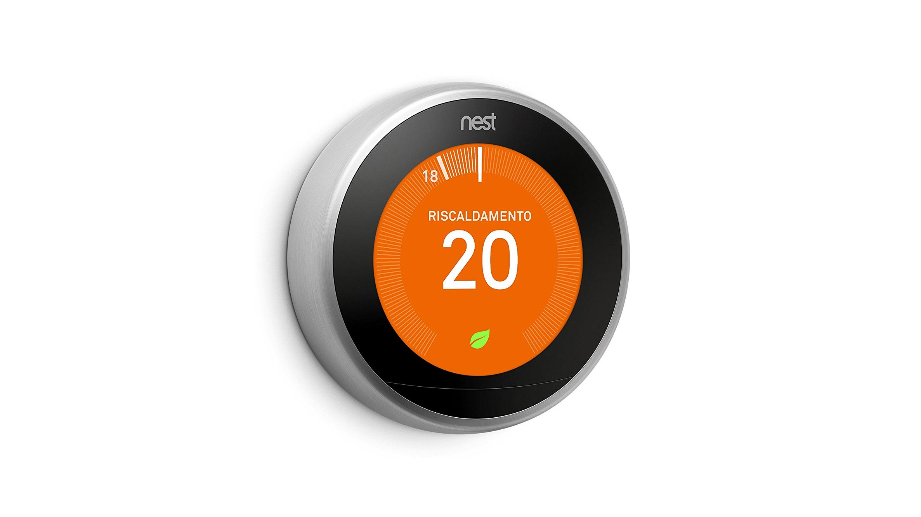
QI
What other data could make a smart thermostat even smarter?
This Photo by Unknown Author is licensed under CC BY-NC-ND

Slide 10

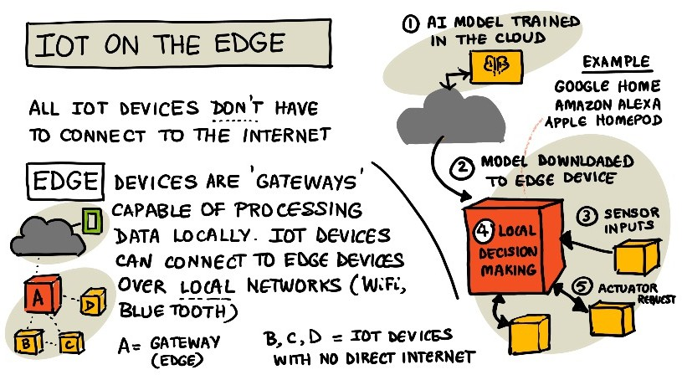
A Device on the Edge

Slide 11
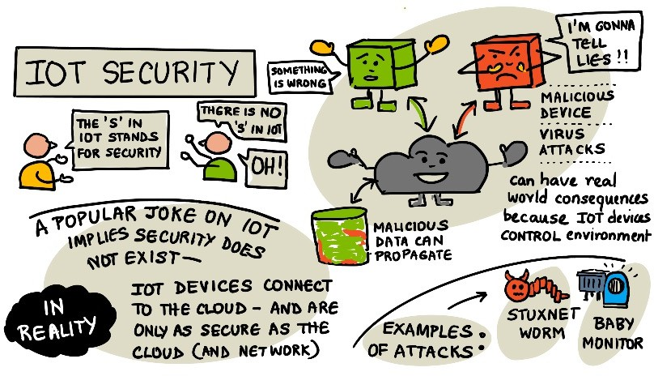

Slide 12
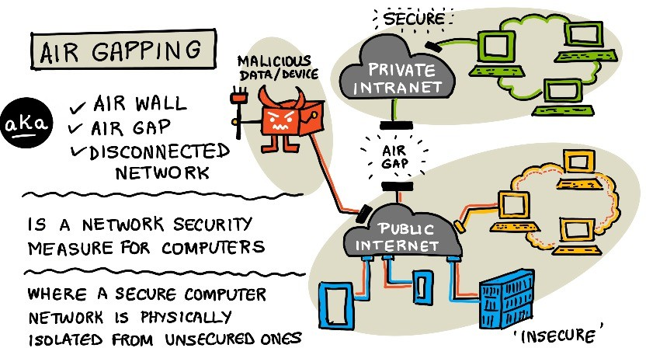

Slide 13
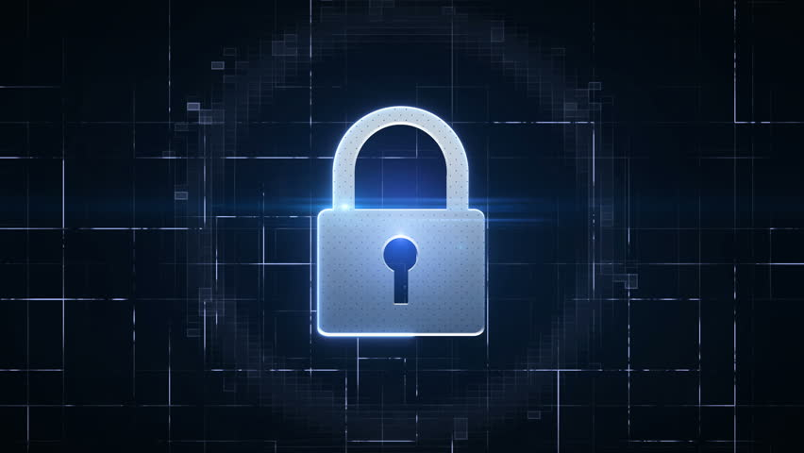
QI
What other security challenges do you think IoT Systems have?

Slide 14
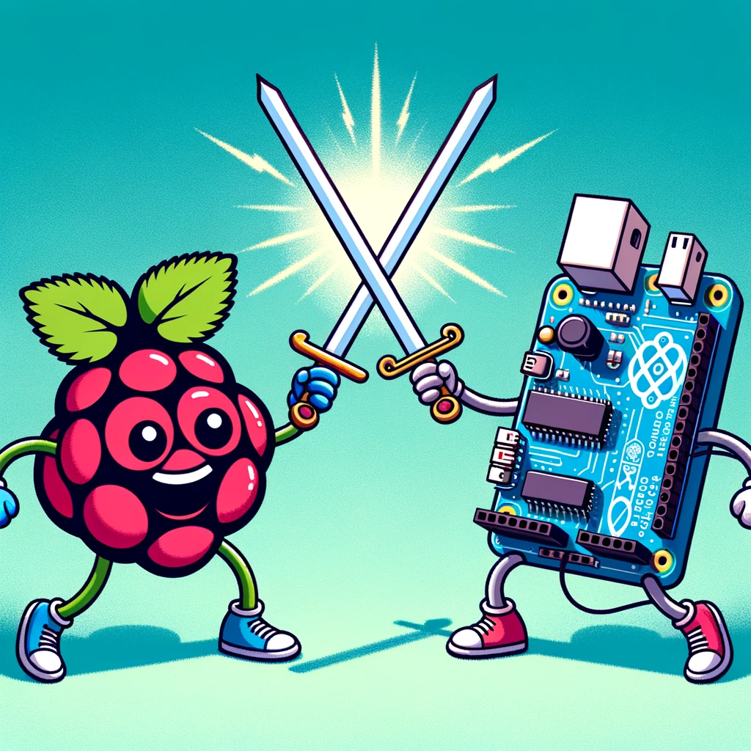
Single Board Computers vs Microcontrollers

Slide 15
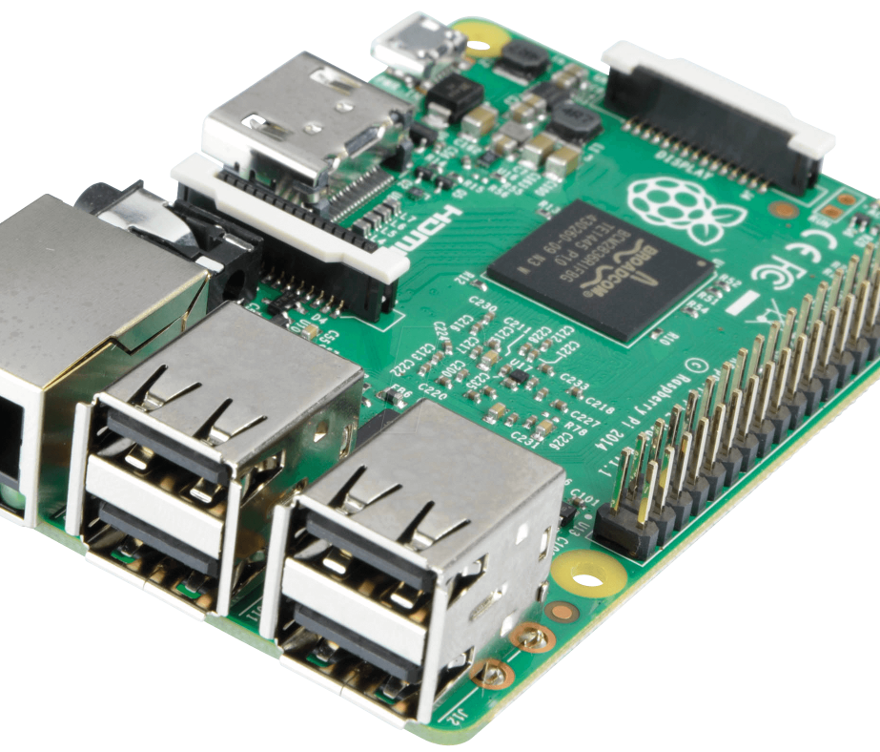
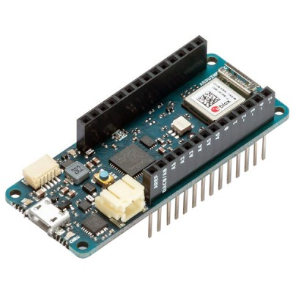
SBC vs μC
Single Board Computer (SBC)
Example: Raspberry Pi
Microcontroller (μC)
Example: Arduino MKR1010 (kind of…)
What are they?
What are key differences?
This Photo by Unknown Author is licensed under CC BY-SA-NC
This Photo by Unknown Author is licensed under CC BY-NC

Slide 16
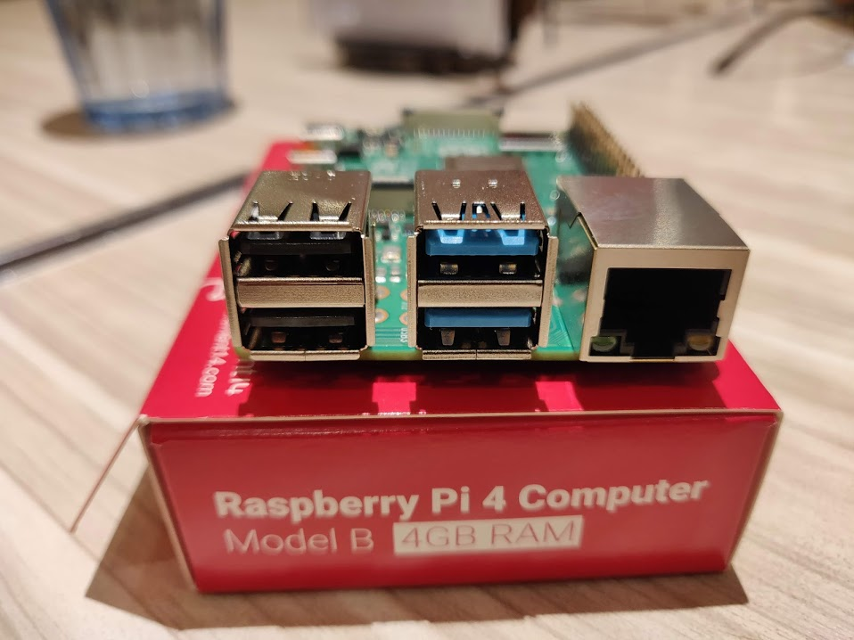
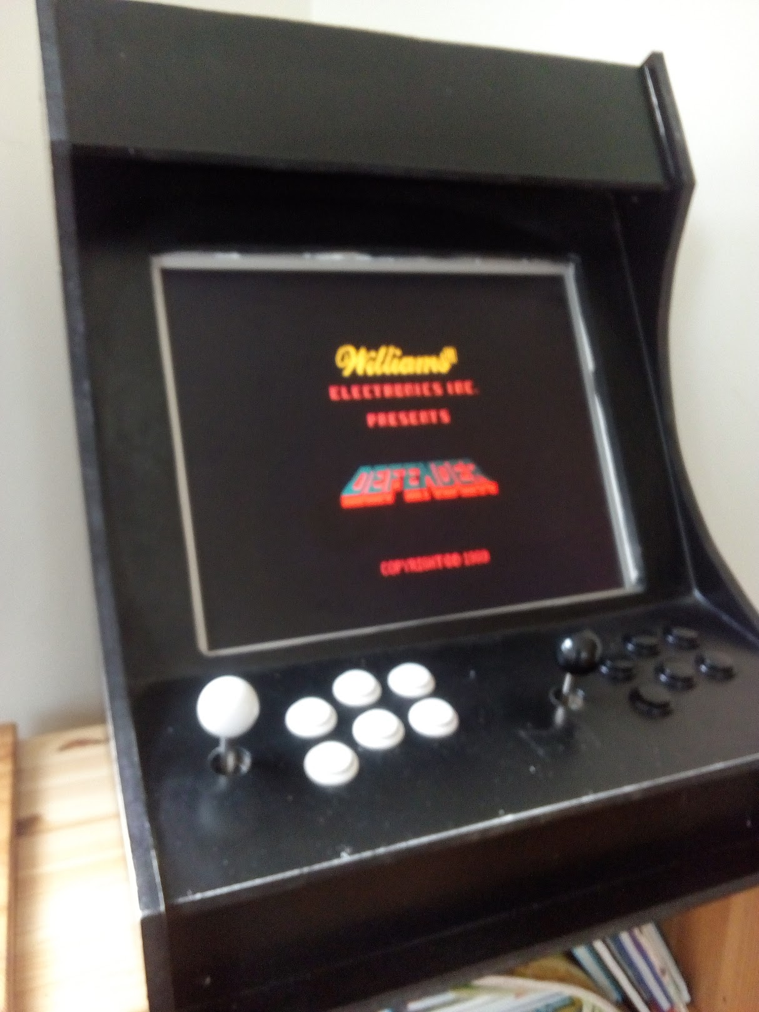
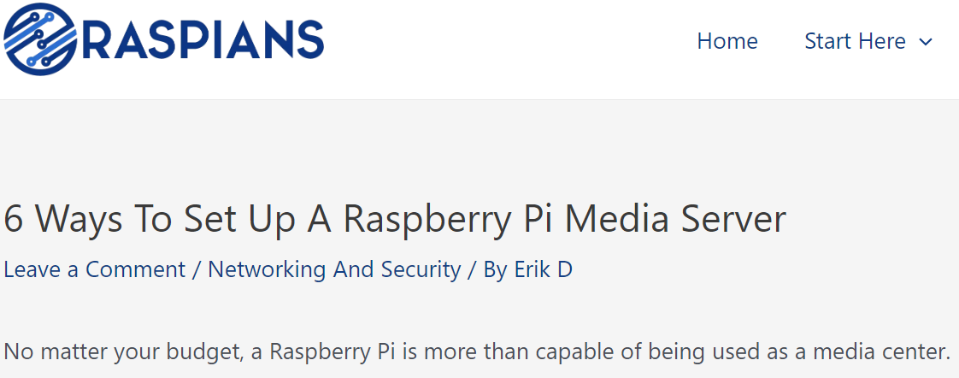
What is a Single Board Computer(SBC)?
A complete computer on a single board
CPU, RAM, storage, and I/O ports.
Runs a full-fledged operating system
Linux distributions
Capable of multitasking, web browsing, and running software applications.
Examples:
This Photo by Unknown Author is licensed under CC BY-SA

Slide 17

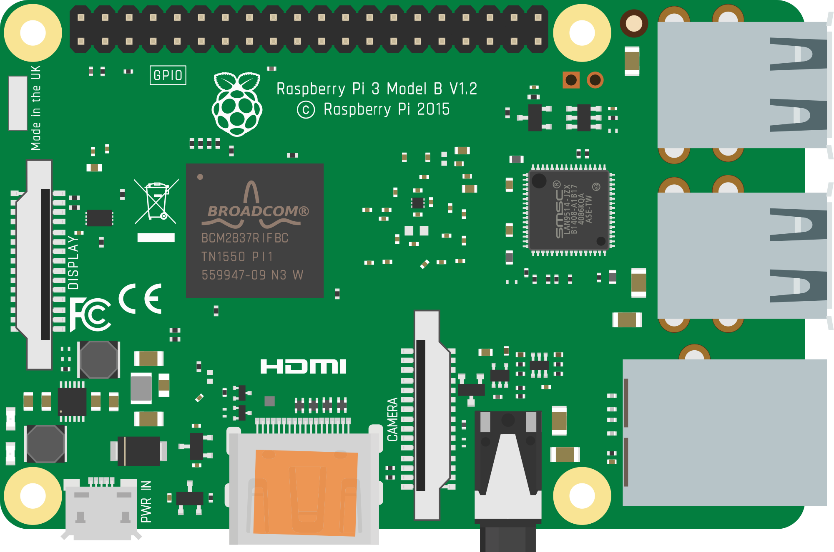
Raspberry Pi
Low cost, single board computer
Linux OS
Same features as most laptops/workstations
40 pin GPIO
USB Ports
LCD Display
RJ45 Ethernet
Power
HDMI
3.5mm audio

Slide 18
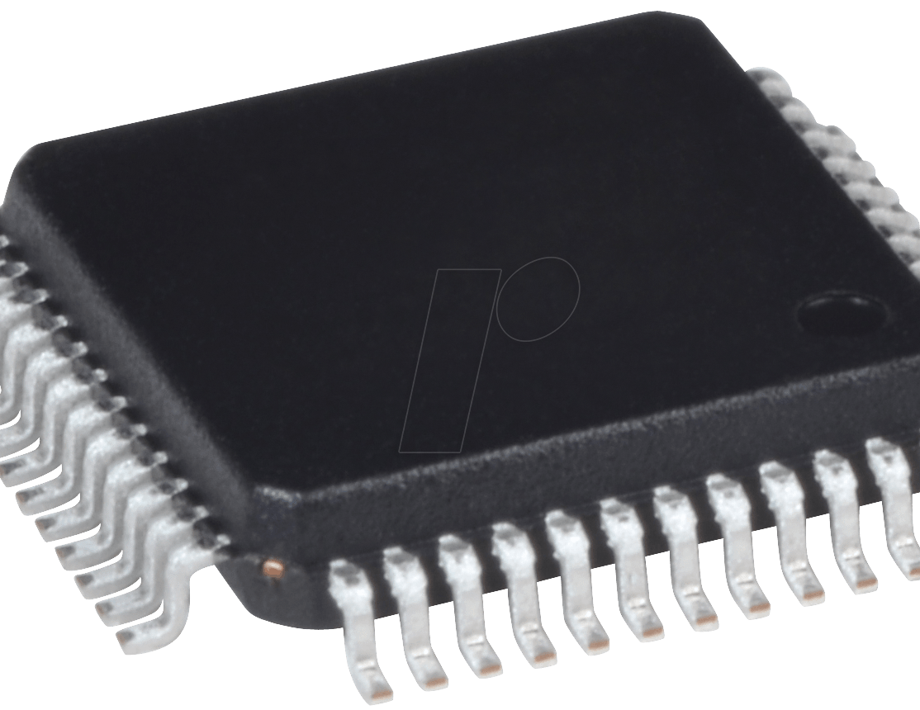
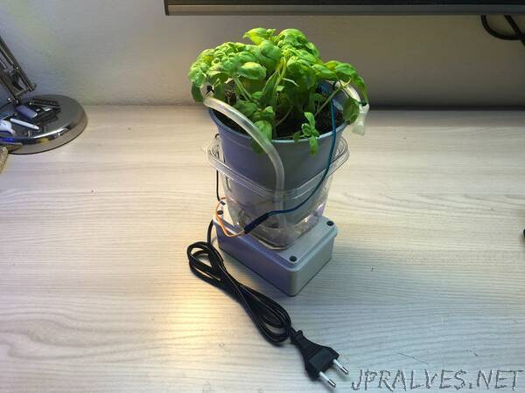
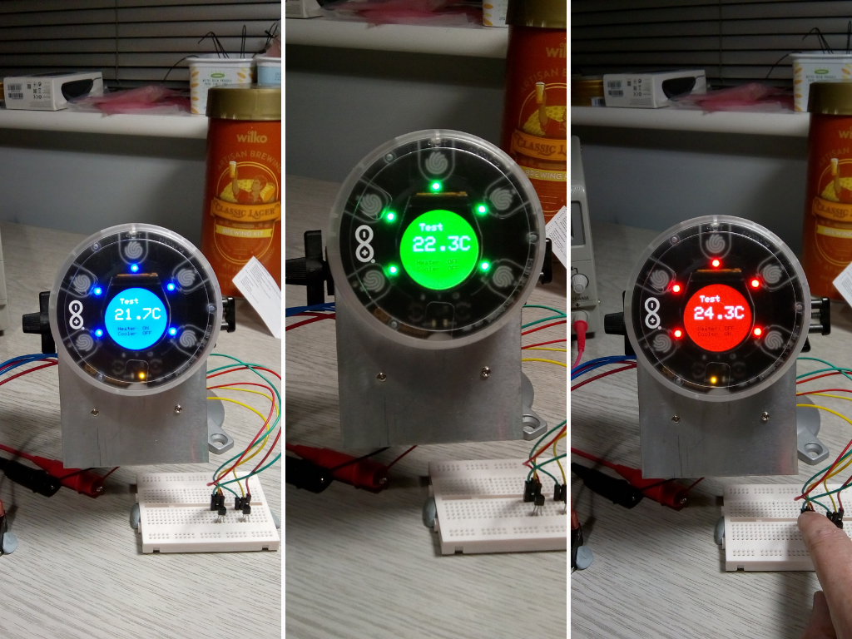
What is a Microcontroller?
A compact circuit designed for specific operations in embedded systems.
Contains a CPU, small RAM, storage, and operates without a full OS.
Executes pre-programmed tasks, ideal for hardware interactions.
Example:
Automated Plant Watering System: An Arduino reads soil moisture levels and automatically waters a plant when it gets too dry.
This Photo by Unknown Author is licensed under CC BY-NC
This Photo by Unknown Author is licensed under CC BY-NC-ND

Slide 19
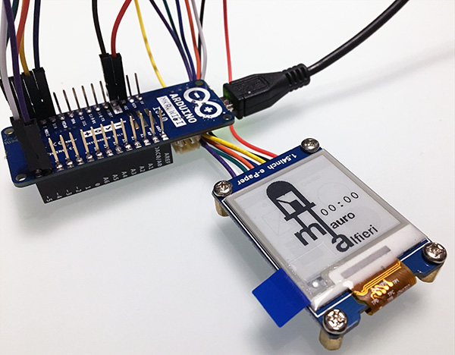
Arduino wifi MKR1010
Powerful μC platform
IoT and network connectivity focused
Good for networking modules!!!
Open source
Large online community
This Photo by Unknown Author is licensed under CC BY-SA-NC

Slide 20
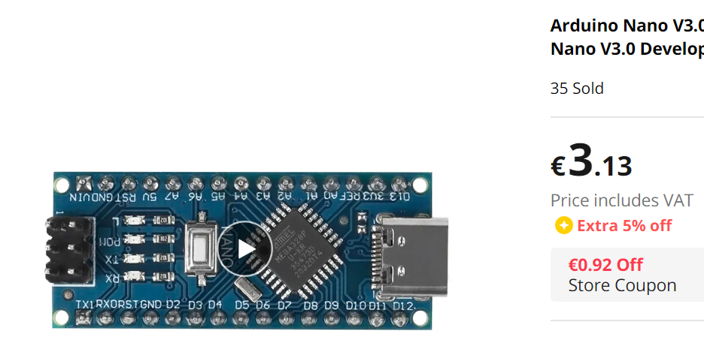
SBCs vs. Microcontrollers Key Differences
Power Consumption: Arduino is more energy-efficient than Raspberry Pi.
Complexity: Raspberry Pi can handle intricate tasks due to its robust CPU architecture, memory resources and OS.
Boot Time: Arduino starts nearly instantly, while Raspberry Pi requires boot-up time(like your laptop).
Cost: Microcontrollers are generally cheaper than SBCs.
Development: Raspberry Pi offers a typical Operating System and desktop-like environment, whereas Arduino requires external coding and uploading.

Slide 21
SBCs vs. Microcontrollers Key Differences
Real-time:
Microcontrollers are generally designed to perform specific tasks without the overhead of an operating system.
Microcontrollers loop continuously waiting for input from sensor the react immediately.
Real-time operation: can guarantee a task is executed in a predictable time frame.
Can use “interrupt” handlers to achieve this. Triggered by a sensor input(e.g. tilt sensor in car)
SBCs generally run full-fledged operating systems like Linux,
can have varying response times due to task scheduling and other processes running in the background.
Microcontrollers can operate in Real-time, SBCs do not.

Slide 22
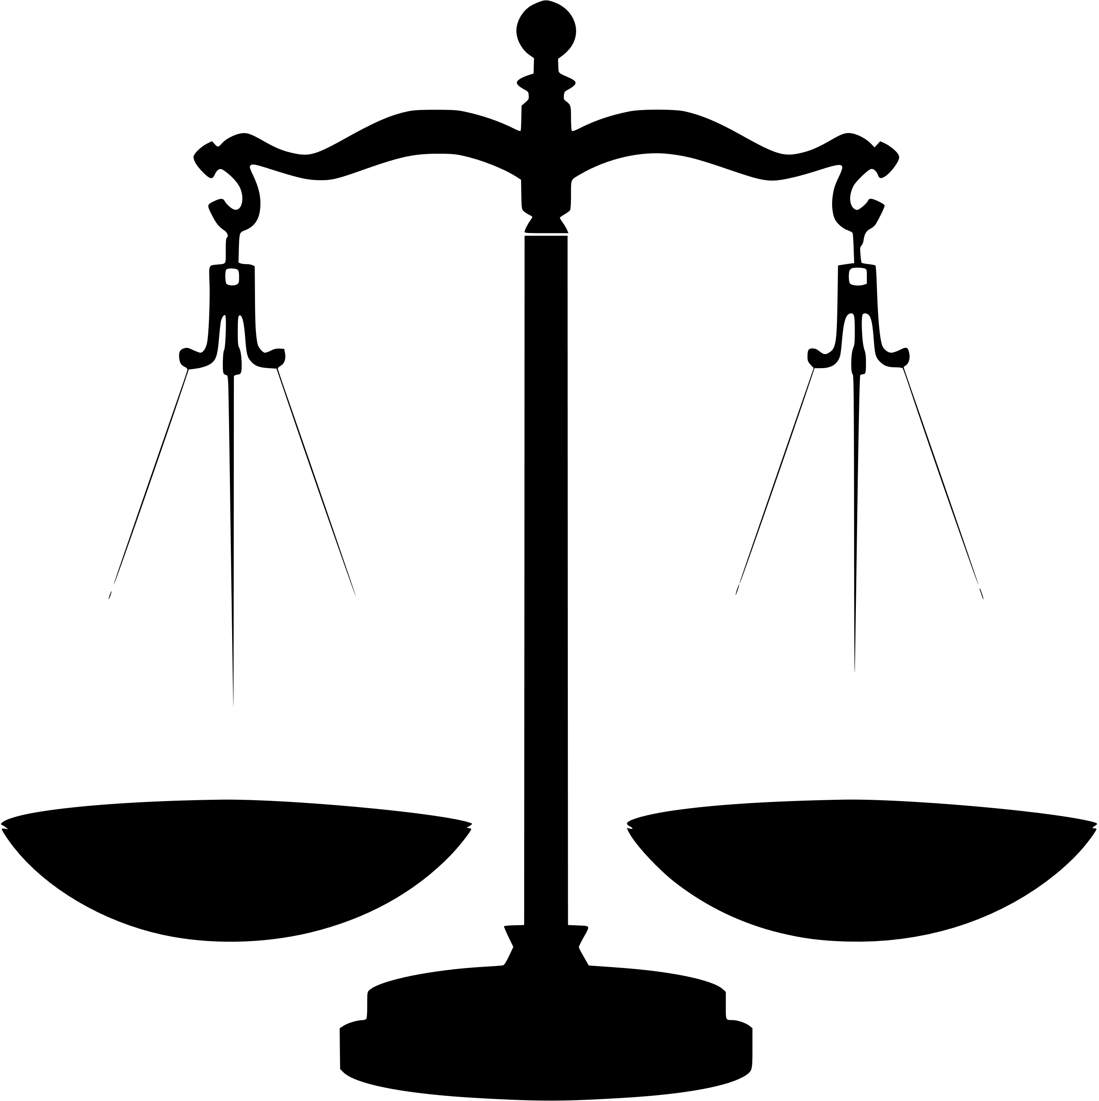
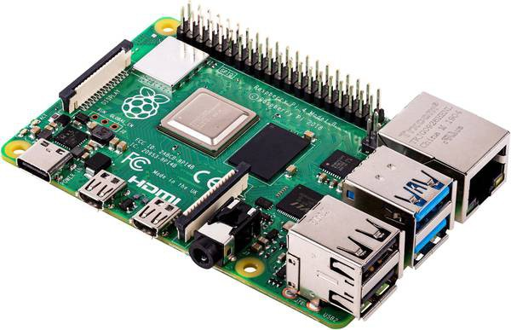
Which one???
Task Simplicity:
Use Arduino for simpler, hardware-focused tasks.
Use Raspberry Pi for complex tasks or when a full OS is beneficial (e.g. image processing, DB I/O).
Power Constraints: For battery-operated or energy-efficient systems, Arduino is often a better choice.
Integration: Raspberry Pi is ideal for projects that need internet connectivity, computation & processing, or integration with complex software.
Budget: Consider cost implications, especially for large scale or commercial projects.

Slide 23
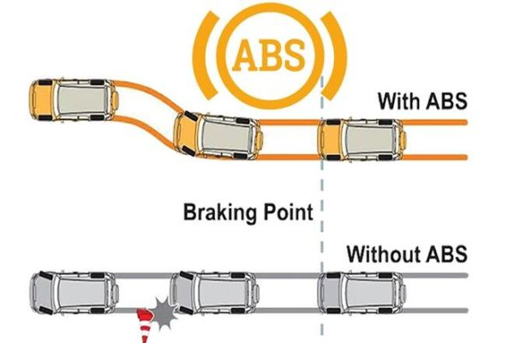
Example Use Case1: ABS
Anti-lock Braking System (ABS)
ABS is a safety anti-skid braking system that prevents the wheels from “locking up” during braking, which helps the driver maintain control.
How it works:
Wheel Speed Sensors constantly measure the speed of each wheel and send this data to the ABS controller.
ABS Controller processes the wheel speed data and determines if a wheel is about to lock up.
If the ABS Controller detects a wheel is about to lock, it decreases the pressure to the brake until the wheel starts moving again.
Safety Critical System: Has to Work Always, Has to be Reliable, Has to be Fast, Can’t be waiting around for processor timeslot
This Photo by Unknown Author is licensed under CC BY-SA-NC

Slide 24
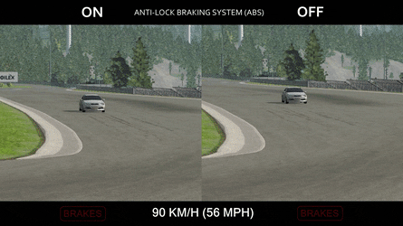
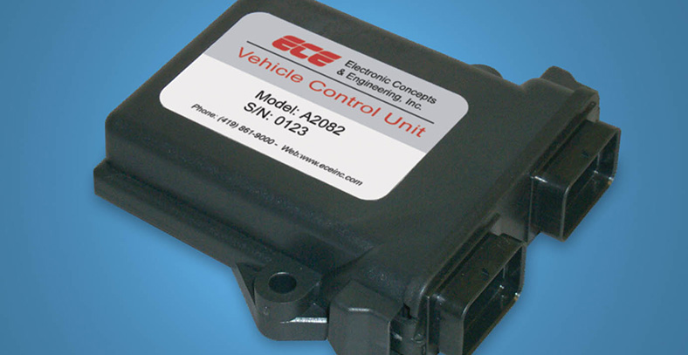
Example Use Case1: ABS
The ABS controller needs to operate in real-time.
When a driver steps on the brake pedal, the ABS must instantly assess and react to wheel slip conditions to prevent skids
A delay in processing could reduce the effectiveness of the ABS, leading to potential accidents.
Microcontroller is the best option here and are used extensively in the automotive industry where safety, performance, and reliability are critical.(Incorporated into ECUs(electronic control units)

Slide 25
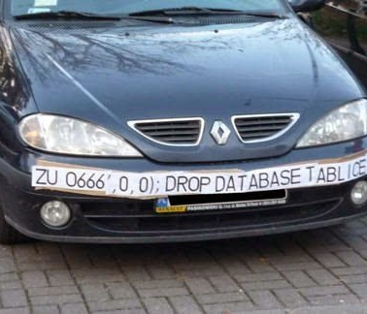
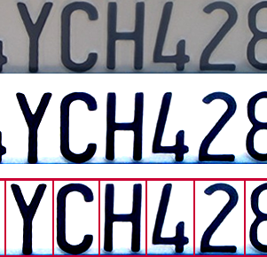
Example Use Case2: Licence Plate Recognition (LPR)
LPR systems automate the process of identifying a vehicle's license plate to manage access, billing, security….
Capture: Cameras take pictures of vehicles' as they come and go.
Image Processing: The system processes these images to enhance clarity, adjust lighting, and prepare the image for plate extraction.
Plate Extraction: Program identify the rectangular region of the image containing the license plate.
Optical Character Recognition: The system then processes this extracted portion to recognise and read the characters on the license plate.
Database: The licence plate number is used to query/update a DB
This Photo by Unknown Author is licensed under CC BY-SA
This Photo by Unknown Author is licensed under CC BY-NC

Slide 26
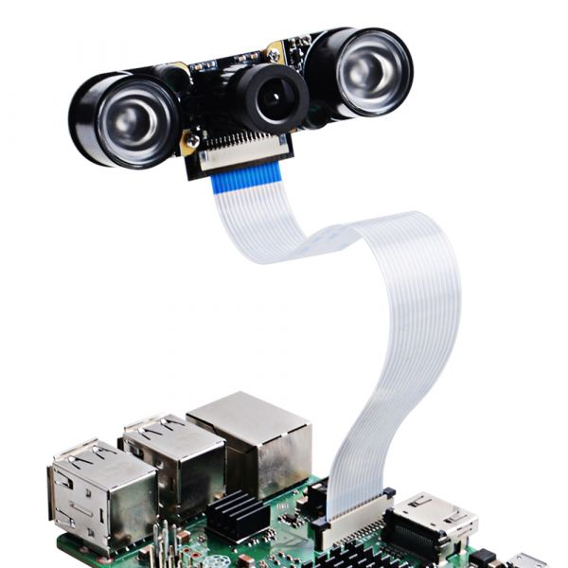
Example Use Case2: Licence Plate Recognition (LPR)
A lot of computationally expensive processing here (image processing). May need a lot of CPU power and memory.
Short period to acquire, process and recognise licence plate is acceptable.
Quick, but not exact real-time processing, is OK.
Nobody will be hurt if it fails – not safety critical.
A networked/connected Single Board Computer connected to Camera is a viable option here.
This Photo by Unknown Author is licensed under CC BY-SA-NC

Slide 27
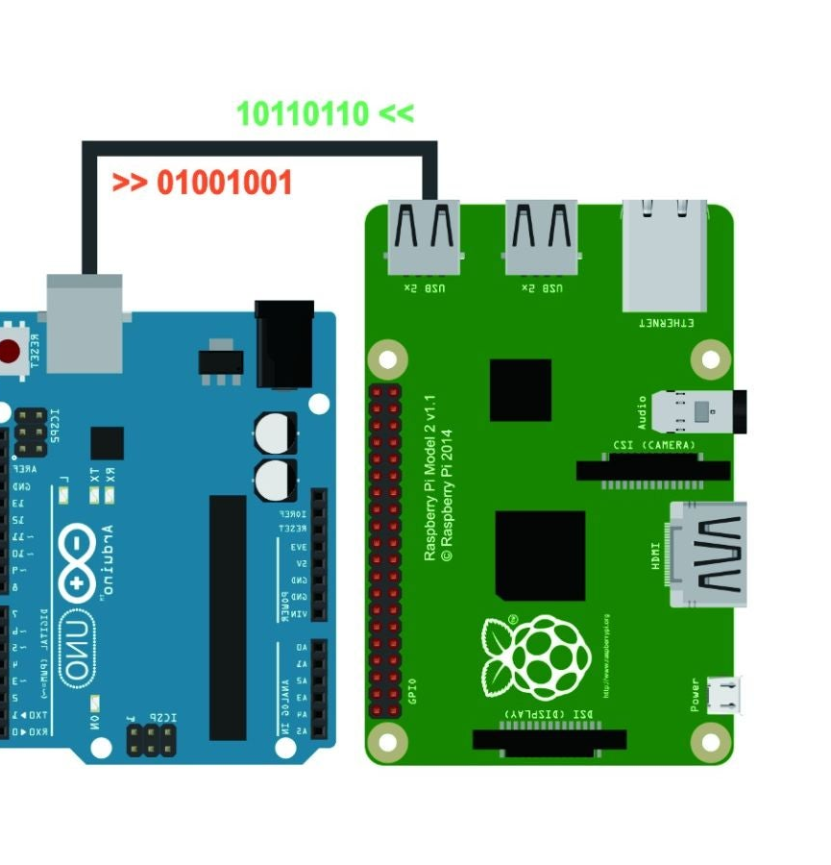
Can you use both together?
Yep! If you want
Why?
Microcontrollers are reliable, real-time and interface well with sensors (analog/digital sensors)
OS on computer have a lot of processing power/software to work on data but can crash and have security vulnerabilities like any computer.
Use Microcontroller to interface/control sensors and actuators
Use SBC to process data/connect to other networks and services.

Slide 28
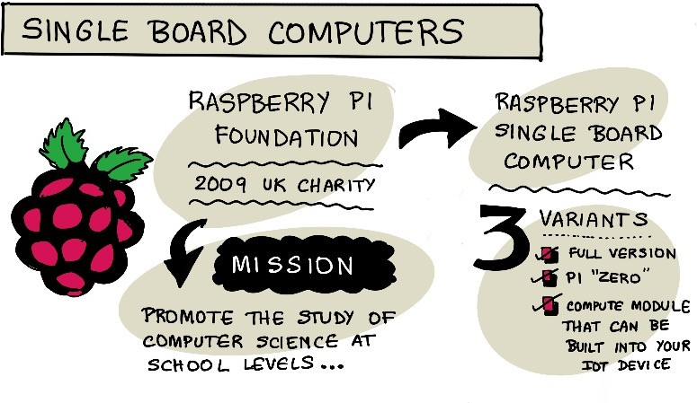

Slide 29
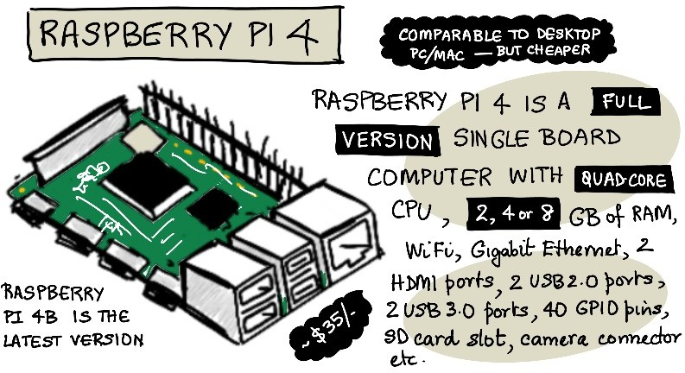

Slide 30
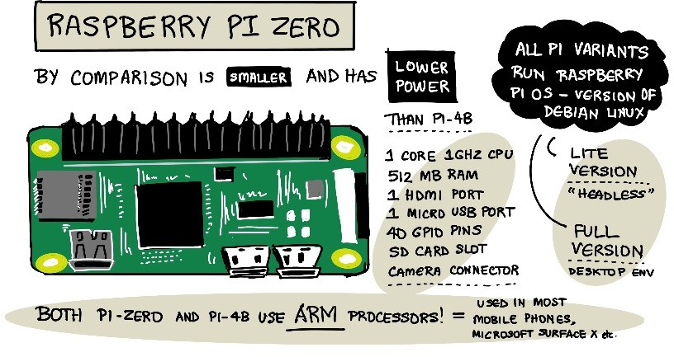

Slide 31
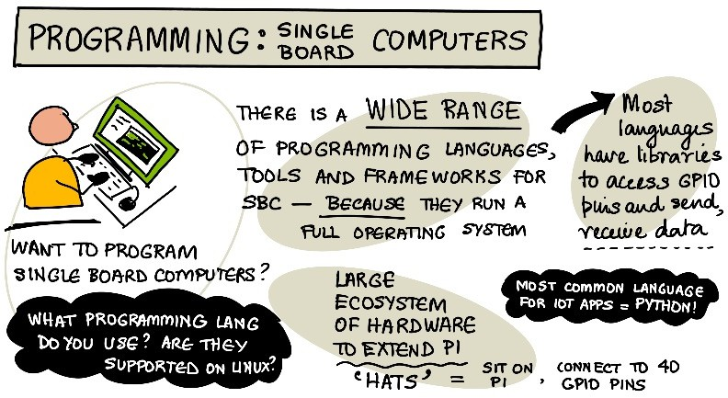

Slide 32
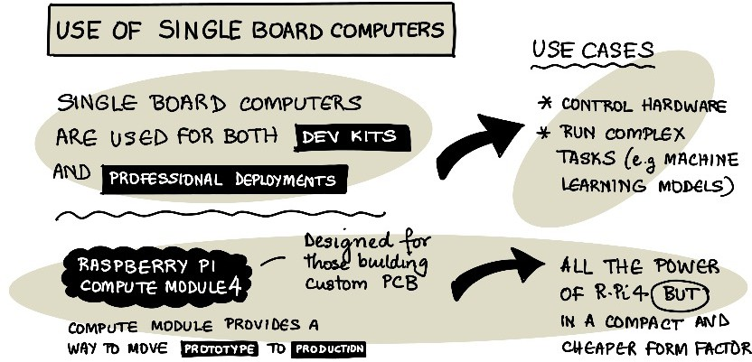

Slide 33
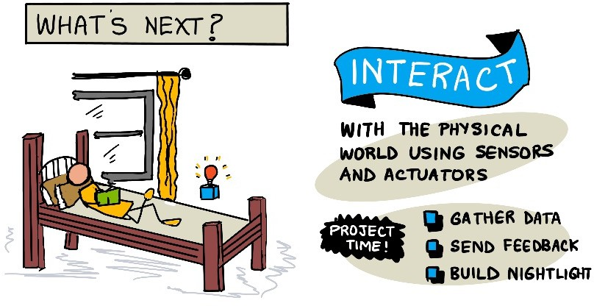

Slide 34
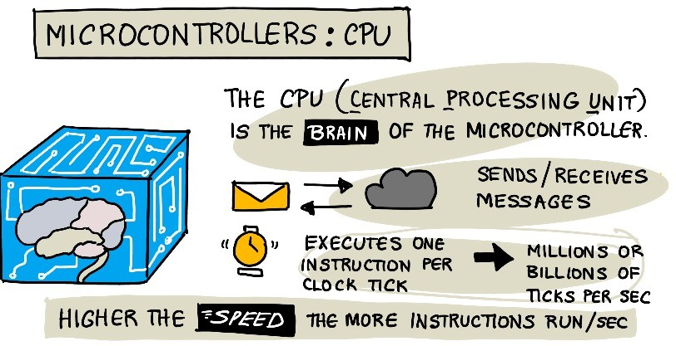

Slide 35
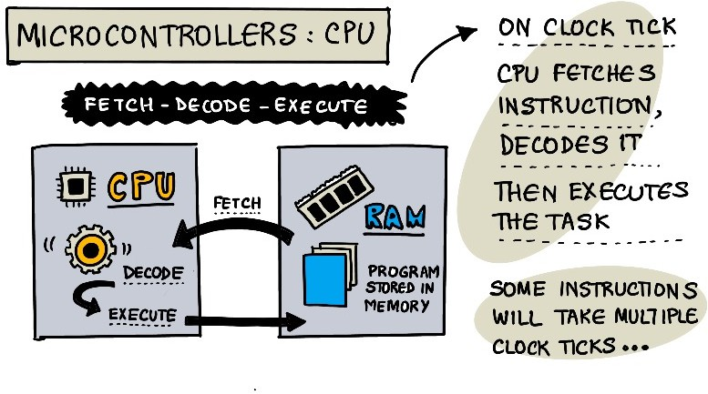

Slide 36
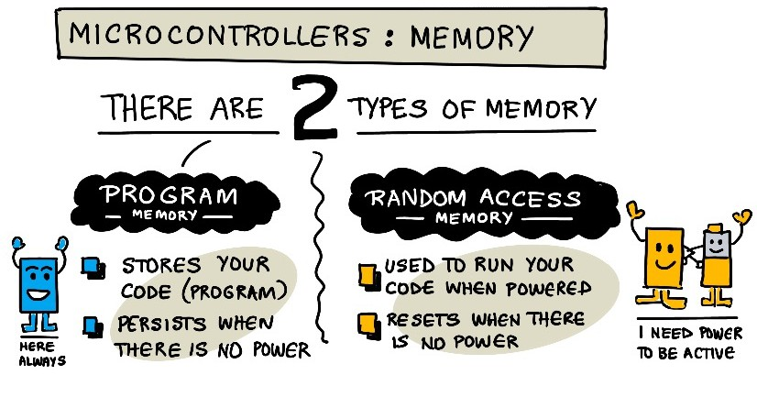

Slide 37
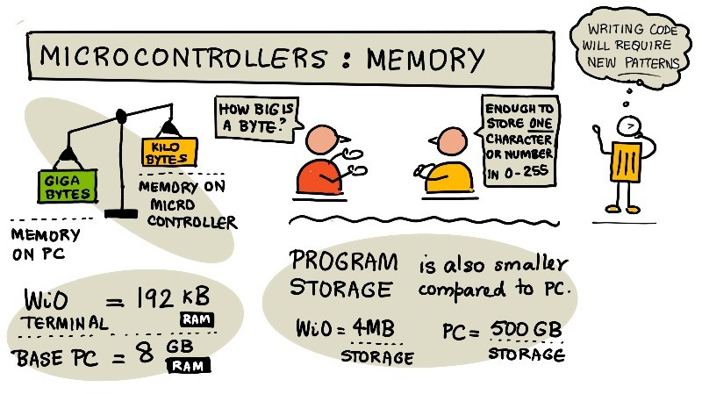

Slide 38
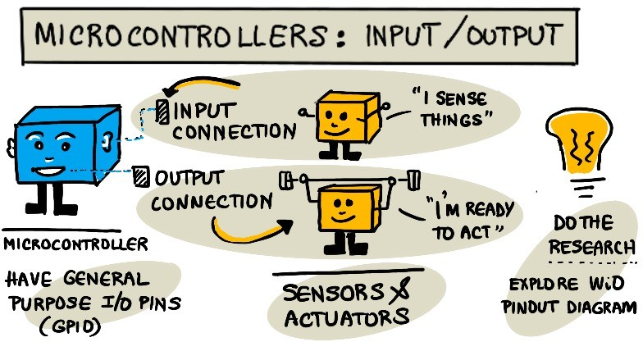

Slide 39
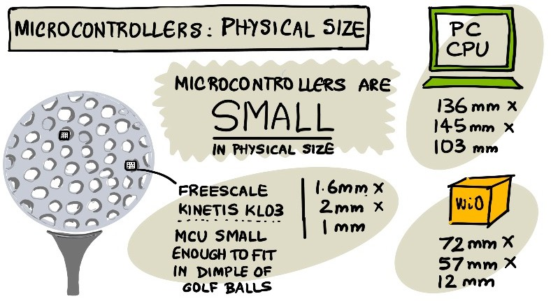

Slide 40
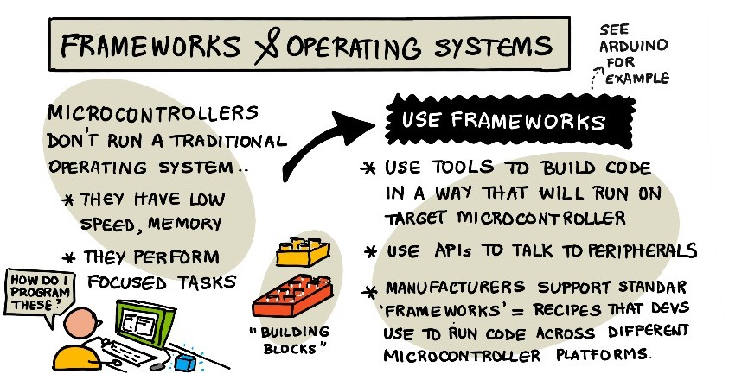

Slide 41
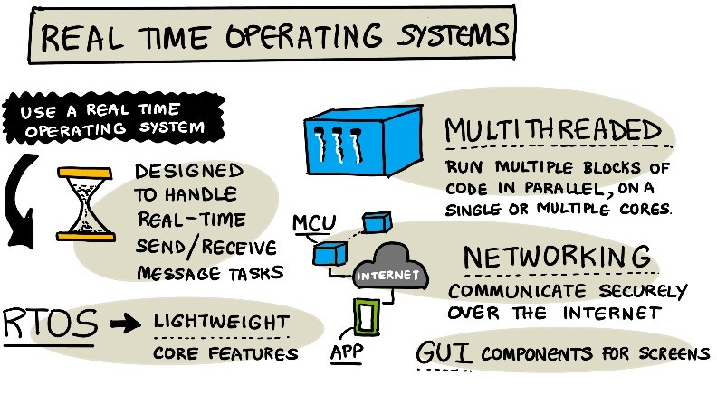

Slide 42
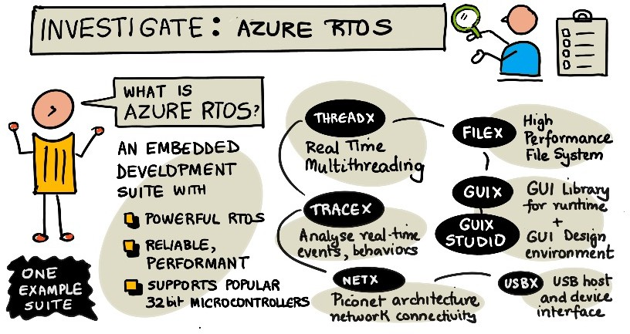

Slide 43
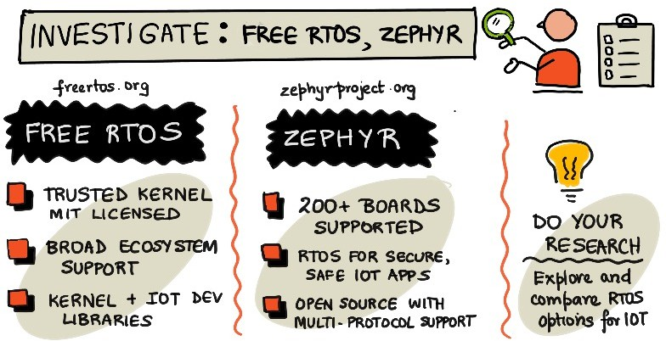

Slide 44
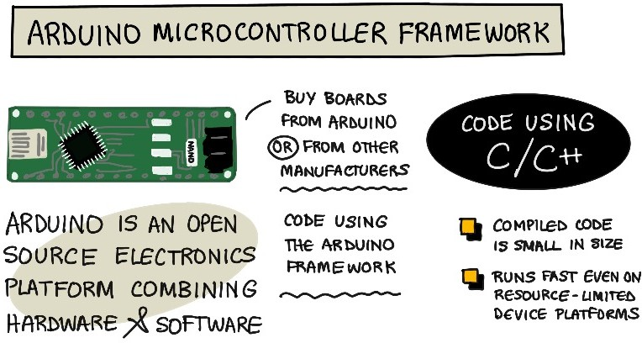

Slide 45
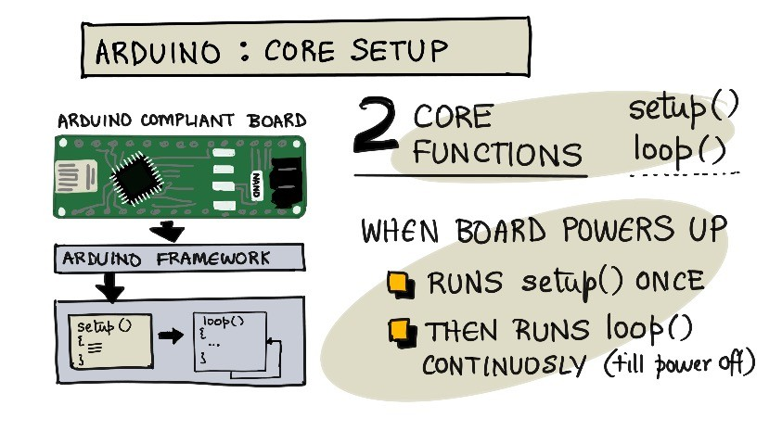
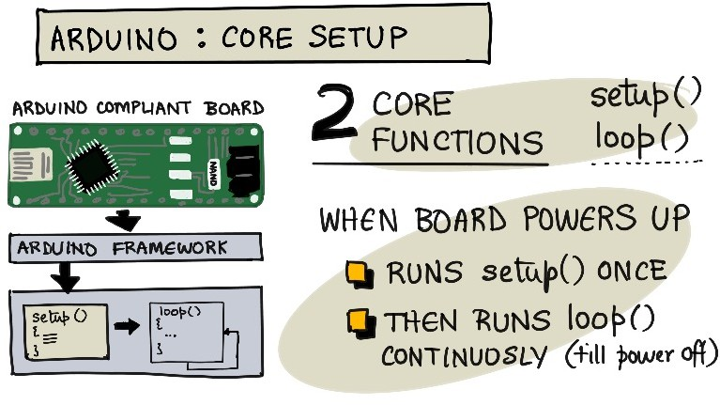

Slide 46


Slide 47


